Slide 1


The Creative Tech Sector (including Visual Technology)
Alison Fox – Harlow Council
West Essex Tech Forum
8th May 2025

Slide 2
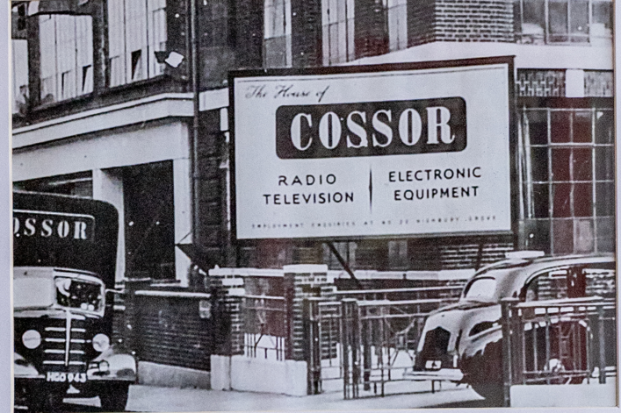
Harlow has a long history of visual technology
Cossor relocated to Harlow in 1958
Corror made values and electronics for TVs
Purchased by Raytheon in 1961

Slide 3
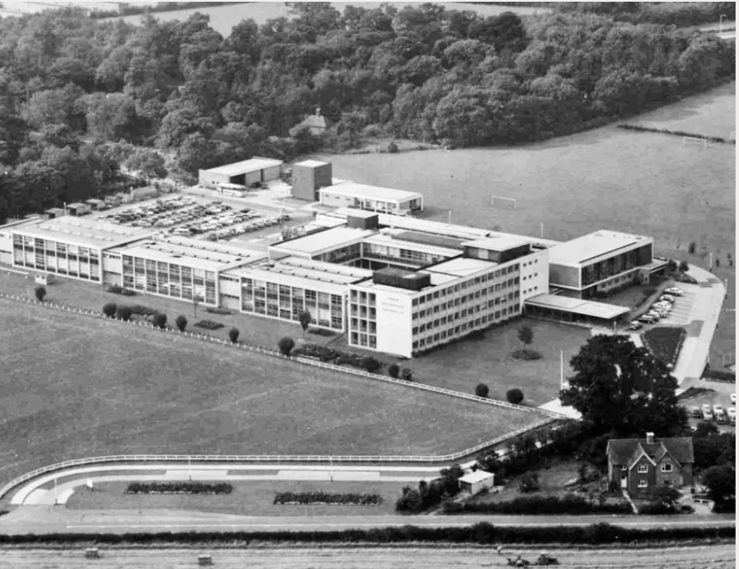
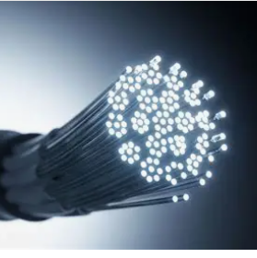
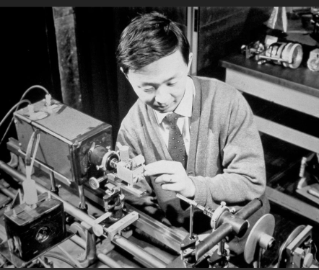
Harlow - the birth place of Optical Fibre
invented at the Standard Telecommunications Laboratories (STC) on London Road
Patent dated 1966
Charles Kao and George Hockham
Optical Fibre:
The enabler for all digital technology
Means that the cost of communicating is no longer directly linked to distance

Slide 4


The Government’s Industrial Strategy Green Paper 2024
included:
Creative industries
Digital and technologies
White Paper is due Summer 2025

Slide 5
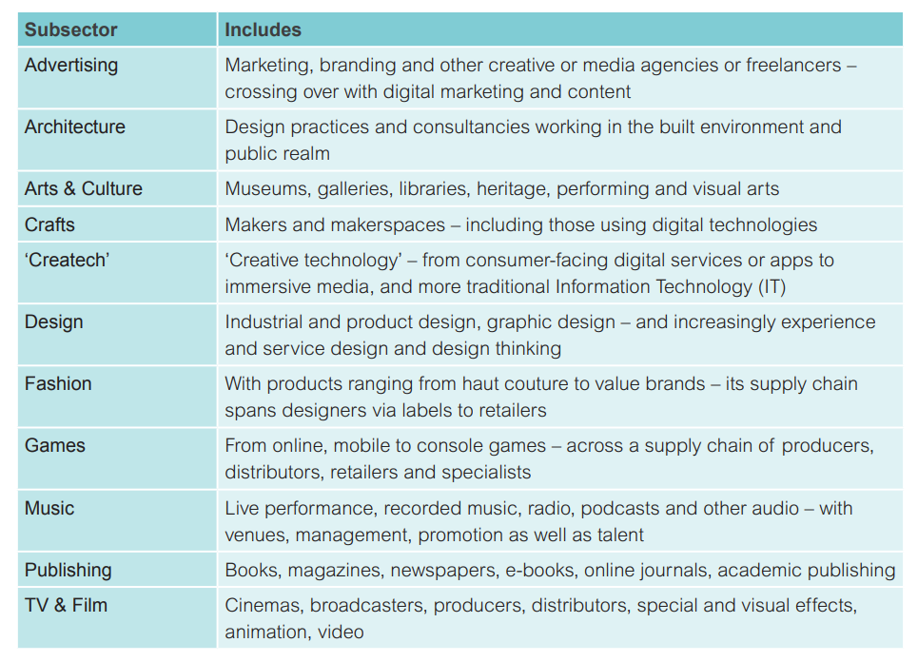
Within the Creative Sector there are many tech and digital aspects

Slide 6
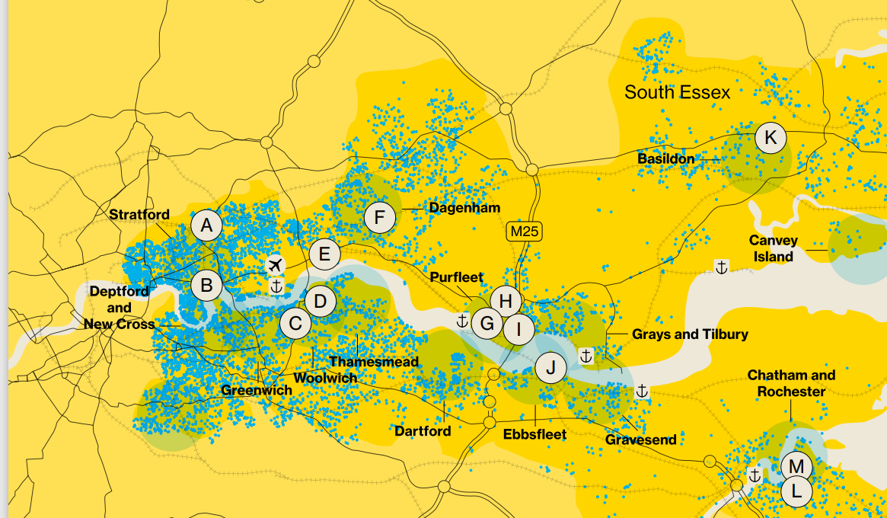
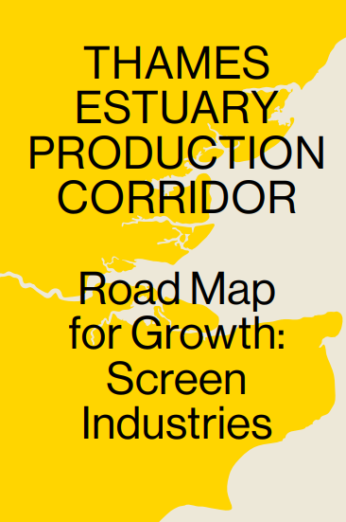
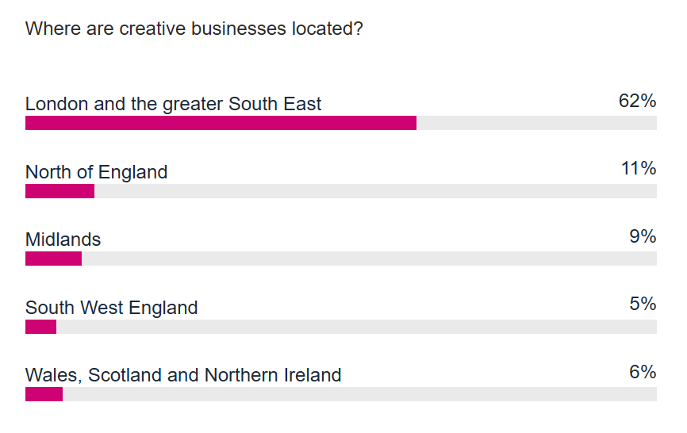
West Essex is a great location for Creative Tech
Thames Estuary Production Corridor
Film studios north of the M25

Slide 7
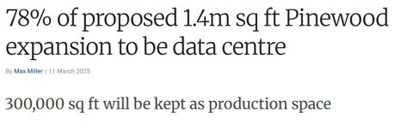
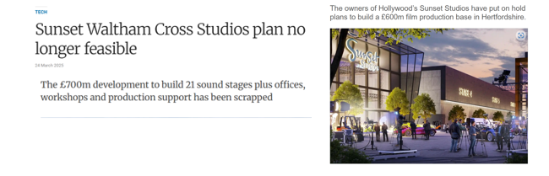

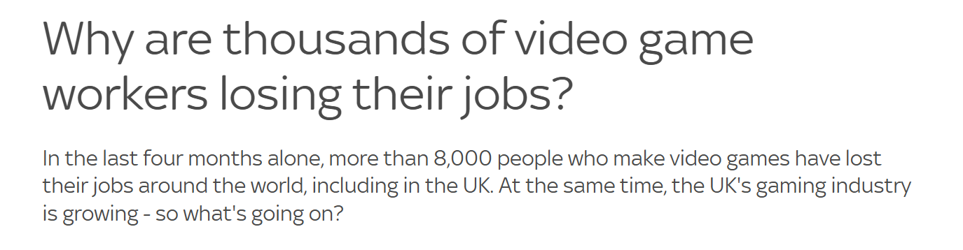
But this is a changing environment

Slide 8

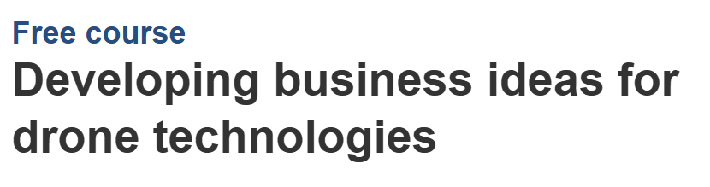
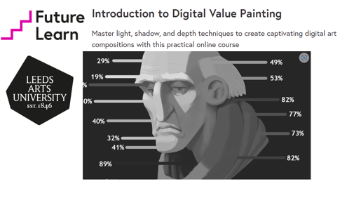



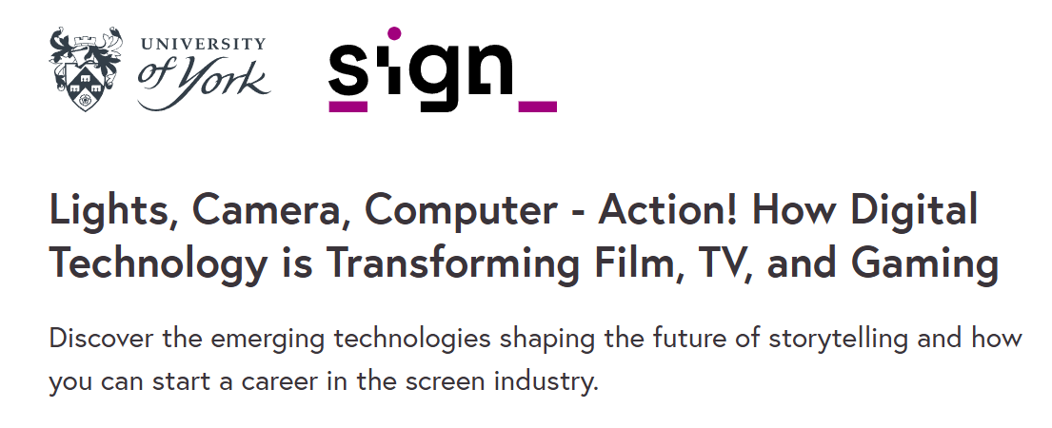
Creating creative resilience:
through Training

Slide 9



Creating creative resilience
Business Support and Funding

Slide 10




